Slide 1


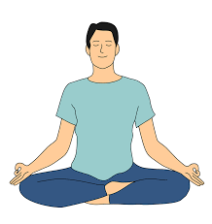
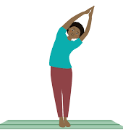
Simplified Kundalini Yoga
In order to enjoy and lead a happy life, one must have good physical, social and mental health. The foundation of this yoga practice lies in a set of simplified physical exercises to maintain a healthy body. It consists of an effective package of breathing and physical exercises to regulate the flow of blood, heat, air and life force in your body, ultimately leading to good health.
These simplified physical exercises consists of the following 8 chapters:
1. Hand Exercise | 2. Leg Exercise | 3. Neuro Exercise | 4. Eye Exercise
5. Breathing Exercise | 6. Torso Exercise | 7. Acupressure &Massage | 8. Relaxation & Meditation
Benefits of Simplified Kundalini Yoga includes the following:
  Help in prevent and cure common diseases
  Increases immunity in the body towards simple ailments
  Improve body strength and longevity for life
  Strengthens heart, lungs, digestive system, brain and nervous system
  Strengthens eyes and improves vision power
  Helps in correcting uterine and menstrual disorders
  Helps in controlling high sugar level in the blood and urine
  Regulates blood pressure and helps to maintain a healthy heart
  Induced good sleep by restoring peace of mind
If you are interested, please use this link https://chat.whatsapp.com/LLkCa8spqCxH3iNBn3zRcd or scan the QR code given below to join the Temple WhatsApp group where information will be posted on our upcoming sessions
Saturdays 7.30 am to 8.30 am
Temple Basement Hall
Duration ~8 weeks

